Slide 1


High Definition Multimedia Interface (HDMI)

Slide 2
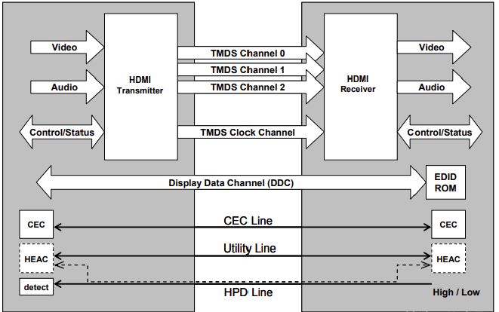
HDMI Overview
HDMI透過4條TMDS差動信號線傳輸影音及時序，其餘信號為高級控制(非必須)，此次lab不會用到。

Slide 3
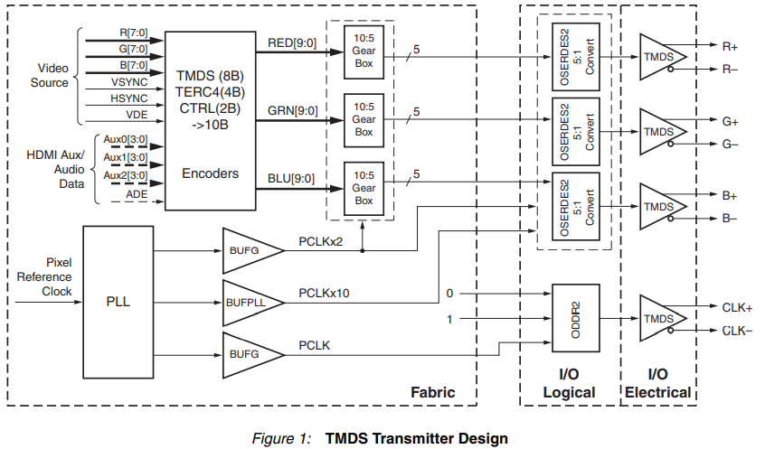
HDMI Overview
HDMI傳輸時需要透過Encode將一般的影音資料轉成TMDS編碼(8 bit to 10 bit)，
再將Parallel資料轉成Serial資料傳輸。

Slide 4
FPGA_HDMI
Hdmi_Trans
VPG
Encode
Parallel to Serial
Single end to Differential
TMDS [3:0]
PLL
Encode
Parallel to Serial
Single end to Differential
Encode
Parallel to Serial
Single end to Differential
Parallel to Serial
Single end to Differential
TMDSI_Tx_clk

Slide 5
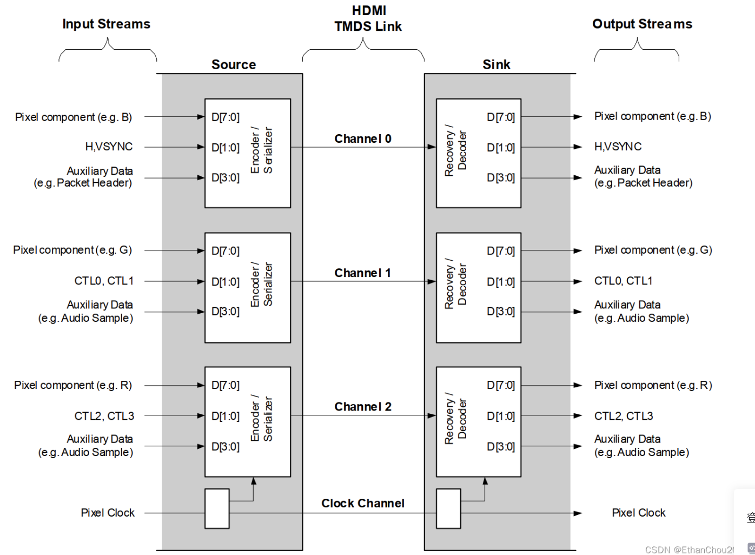
FPGA_HDMI
Encode模塊將Pixel,H.V_SYNC及音訊等額外數據編碼成10bit的TMDS編碼

Slide 6
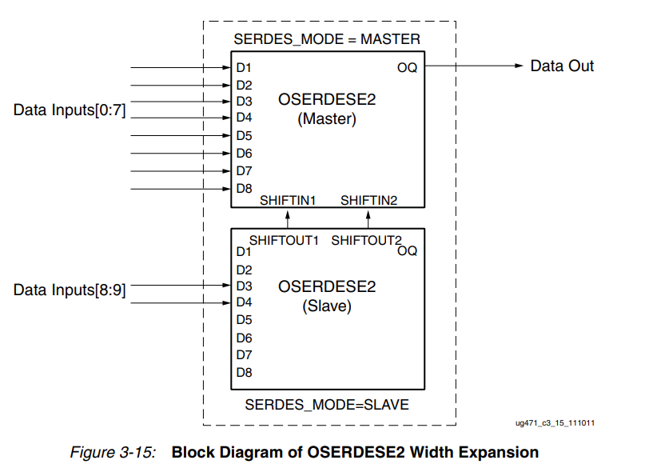
FPGA_HDMI
OSERDESE2為XILINX專門的串並轉換器，透過級聯可以一次輸出10bit的Serial資料(詳情可參考U.G 471)

Slide 7
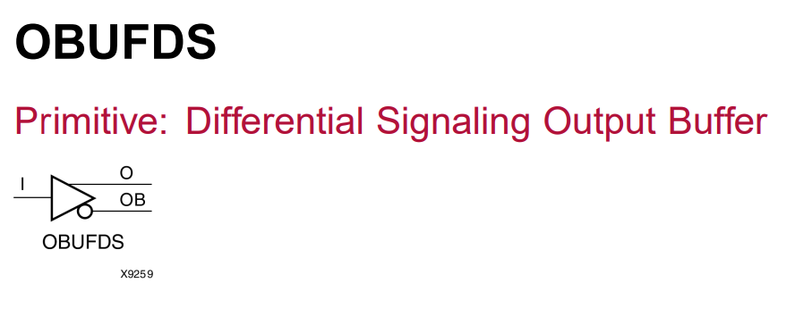
FPGA_HDMI
OBUFDS為XILINX的差分輸出緩衝器，可將FPGA內部信號轉成TMDS等差分信號(詳情參考U.G 471)

Slide 8
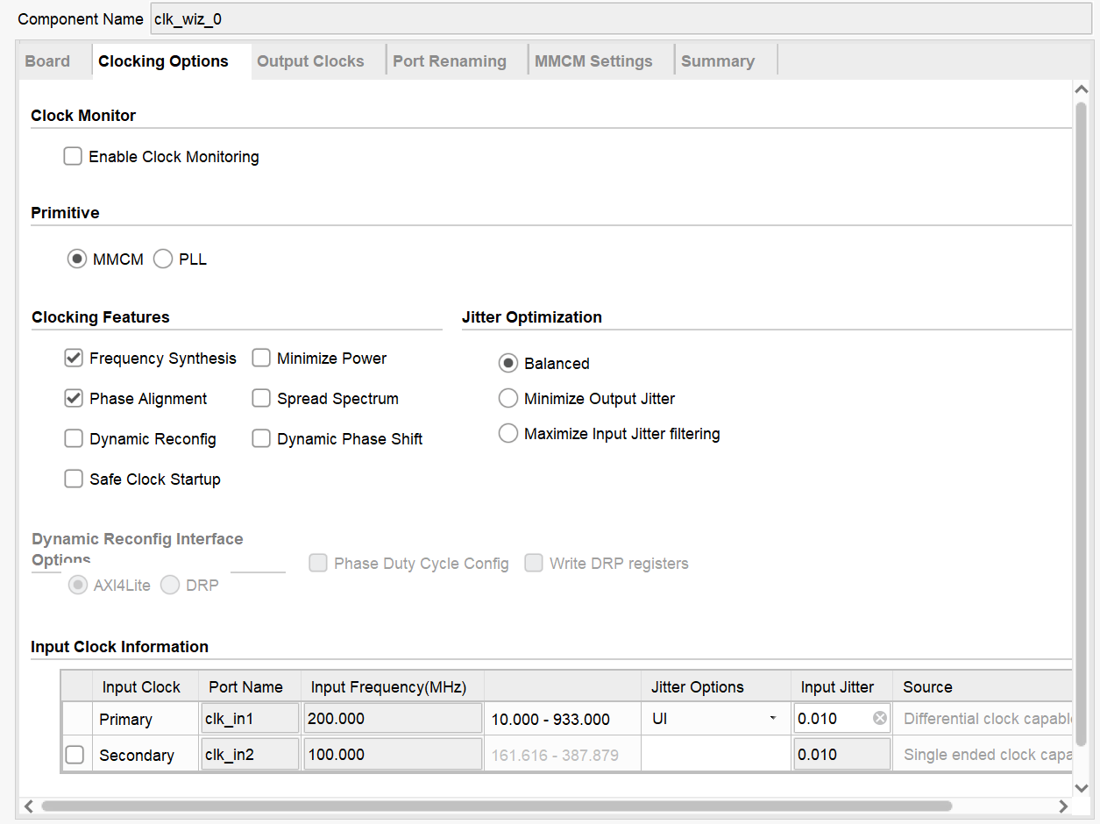
PLL IP Setting
PLL IP Setting

Slide 9
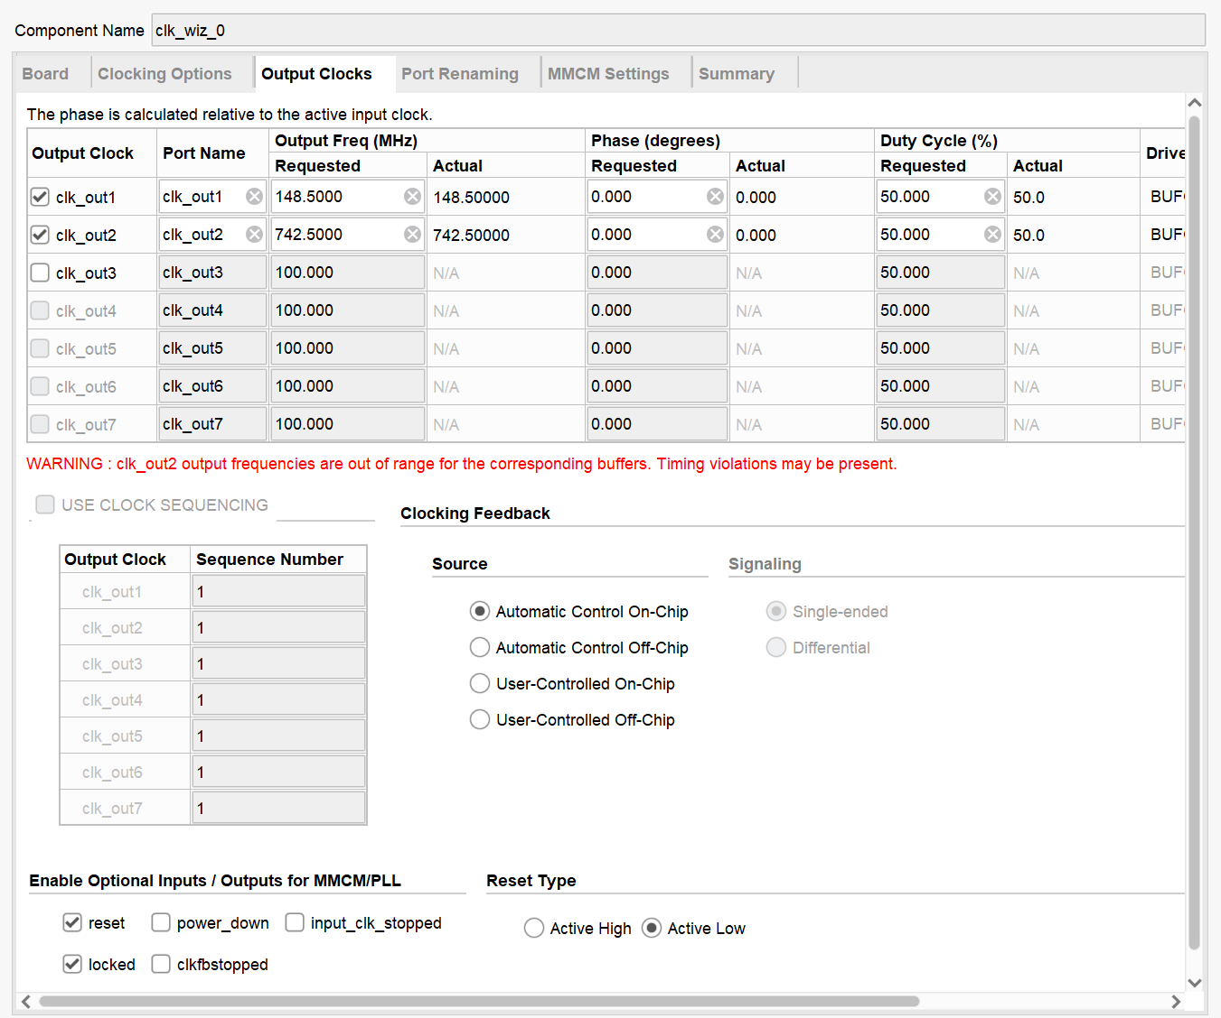
PLL IP Setting
PLL IP Setting

Slide 10
HDMI_trans_top
Port define
`timescale 1ns / 1ps
module hdmi_trans_top(
input wire clk_in1_p ,
input wire clk_in1_n ,
input wire rst_n ,
output wire hdmi_oen ,
output wire hdmi_tx_clk_n ,
output wire hdmi_tx_clk_p ,
output wire hdmi_tx_chn_r_n ,
output wire hdmi_tx_chn_r_p ,
output wire hdmi_tx_chn_g_n ,
output wire hdmi_tx_chn_g_p ,
output wire hdmi_tx_chn_b_n ,
output wire hdmi_tx_chn_b_p
);

Slide 11
HDMI_trans_top
wire define
parameter CNT_MAX = 1000 ;
wire locked ;
wire rst ;
wire clk1x ;
wire clk5x ;
wire [7:0] rgb_r ;
wire [7:0] rgb_g ;
wire [7:0] rgb_b ;
wire vpg_de ;
wire vpg_hs ;
wire vpg_vs ;
reg hdmi_oen_r ;
reg [10:0] cnt ;
assign rst = ~locked ;
assign hemi_oen = hdmi_oen_r ;

Slide 12
HDMI_trans_top
Counter & hdmi_enable
always@(posedge clk1x)begin
if(rst)
cnt <= 'd0;
else if(cnt < CNT_MAX)
cnt <= cnt + 1'b1;
else
cnt <= cnt;
end
always@(posedge clk1x)begin
if(rst)
hdmi_oen_r <= 1'b0;
else if(cnt <= CNT_MAX)
hdmi_oen_r <= 1'b1;
end

Slide 13
HDMI_trans_top
Pll inst & Video_Pattern inst
clk_wiz_0 inst_clock
(
// Clock out ports
.clk_out1(clk1x), // output clk_out1
.clk_out2(clk5x), // output clk_out2
// Status and control signals
.resetn(rst_n), // input reset
.locked(locked), // output locked
// Clock in ports
.clk_in1_p(clk_in1_p), // input clk_in1_p
.clk_in1_n(clk_in1_n) // input clk_in1_n
);
vga_shift inst_vga_shift
(
.rst(rst),
.vpg_pclk(clk1x),
.vpg_de(vpg_de),
.vpg_hs(vpg_hs),
.vpg_vs(vpg_vs),
.rgb_r(rgb_r),
.rgb_g(rgb_g),
.rgb_b(rgb_b)
);

Slide 14
HDMI_trans_top
HDMI_trans inst
hdmi_trans inst_hdmi_trans
(
.clk1x(clk1x),
.clk5x(clk5x),
.rst(rst),
.image_r(rgb_r),
.image_g(rgb_g),
.image_b(rgb_b),
.vsync(vpg_vs),
.hsync(vpg_hs),
.de(vpg_de),
.hdmi_tx_clk_n(hdmi_tx_clk_n),
.hdmi_tx_clk_p(hdmi_tx_clk_p),
.hdmi_tx_chn_r_n(hdmi_tx_chn_r_n),
.hdmi_tx_chn_r_p(hdmi_tx_chn_r_p),
.hdmi_tx_chn_g_n(hdmi_tx_chn_g_n),
.hdmi_tx_chn_g_p(hdmi_tx_chn_g_p),
.hdmi_tx_chn_b_n(hdmi_tx_chn_b_n),
.hdmi_tx_chn_b_p(hdmi_tx_chn_b_p)
);
endmodule

Slide 15
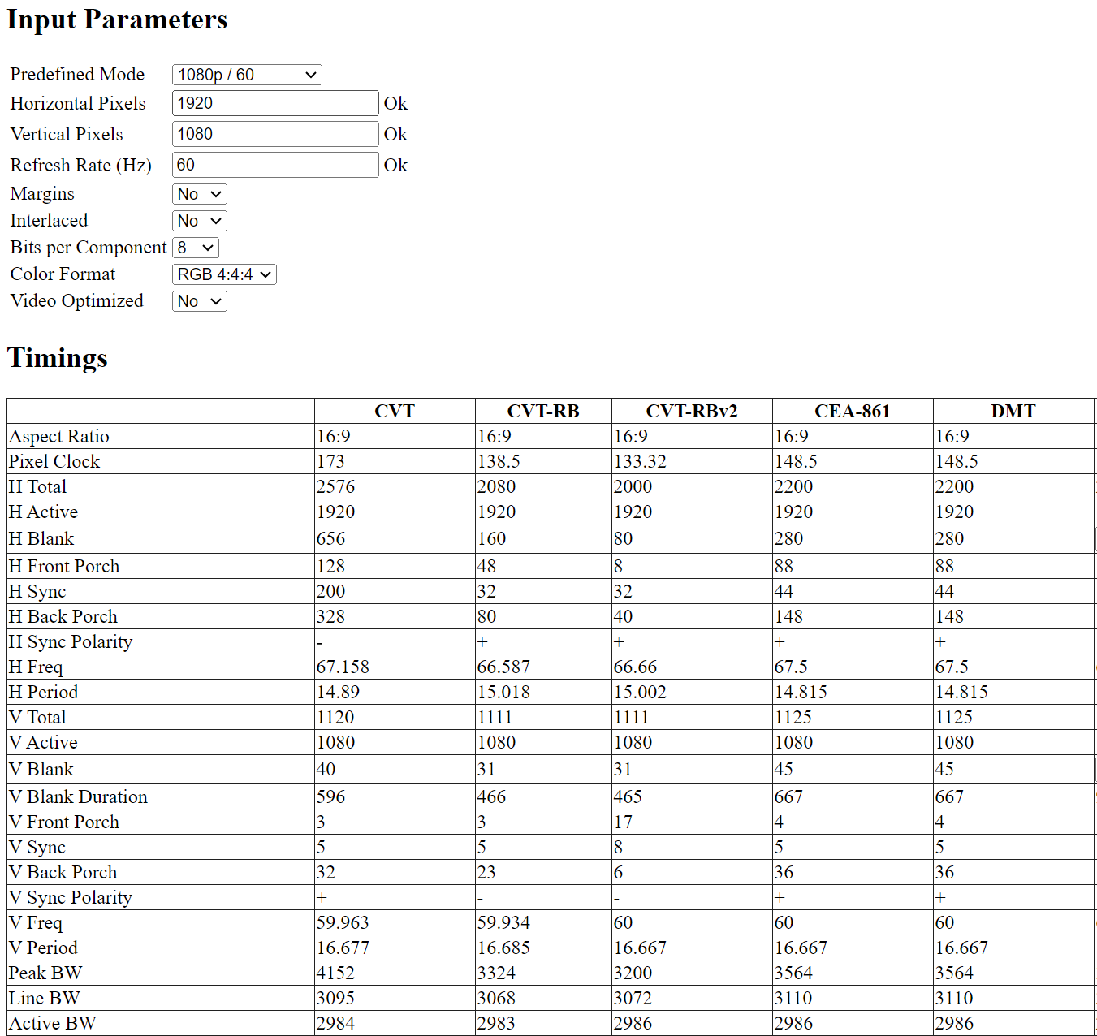
Vga_shift
Port degine & parameter
`timescale 1ns / 1ps
module vga_shift(
input wire rst ,
input wire vpg_pclk ,
output reg vpg_de ,
output reg vpg_hs ,
output reg vpg_vs ,
output wire [7:0] rgb_r ,
output wire [7:0] rgb_g ,
output wire [7:0] rgb_b
);
parameter H_TOTAL = 2200 - 1 ;
parameter H_SYNC = 44 - 1 ;
parameter H_START = 190 - 1 ;
parameter H_END = 2110 - 1 ;
parameter V_TOTAL = 1125 - 1 ;
parameter V_SYNC = 5 - 1 ;
parameter V_START = 41 - 1 ;
parameter V_END = 1121 - 1 ;
parameter SQUARE_X = 500 ;
parameter SQUARE_Y = 500 ;
parameter SCREEN_X = 1920 ;
parameter SCREEN_Y = 1080 ;

Slide 16
Vga_shift
Reg define
reg [12:0] cnt_h ;
reg [12:0] cnt_v ;
reg [11:0] x ;
reg flag_x ;
reg [11:0] y ;
reg flag_y ;
reg [23:0] rgb ;
assign {rgb_r , rgb_g , rgb_b } = rgb ;

Slide 17
Vga_shift
Counter
always@(posedge vpg_pclk)begin
if(rst)
cnt_h <= 'd0;
else if(cnt_h == H_TOTAL)
cnt_h <= 'd0;
else
cnt_h <= cnt_h + 1'b1;
end
always@(posedge vpg_pclk)begin
if(rst)
cnt_v <= 'd0;
else if(cnt_v == V_TOTAL && cnt_h == H_TOTAL)
cnt_v <= 'd0;
else if(cnt_h == H_TOTAL)
cnt_v <= cnt_v + 1'b1;
end

Slide 18
Vga_shift
H_sync & V_sync
always@(posedge vpg_pclk)begin
if(rst)
vpg_hs <= 1'b1;
else if(cnt_h == H_TOTAL)
vpg_hs <= 1'b1;
else if(cnt_h == H_TOTAL)
vpg_hs <= 1'b0;
end
always@(posedge vpg_pclk)begin
if(rst)
vpg_vs <= 1'b1;
else if(cnt_v == V_TOTAL && cnt_h == H_TOTAL)
vpg_vs <= 1'b1;
else if(cnt_v == V_SYNC && cnt_h == H_TOTAL)
vpg_vs <= 1'b0;
end

Slide 19
Vga_shift
Vpg_enable
always@(posedge vpg_pclk)begin
if(rst)
vpg_de <= 1'b1;
else if((cnt_h >= H_START) && (cnt_h < H_END) && (cnt_v >= V_START) && (cnt_v < V_END))
vpg_de <= 1'b1;
else
vpg_de <= 1'b0;
end

Slide 20
Vga_shift
Video output x_axis
always@(posedge vpg_pclk)begin
if(rst)
x <= 'd0;
else if(flag_x == 1'b0 && cnt_v == V_TOTAL && cnt_h == H_TOTAL)
x <= x + 1'b1;
else if(flag_x == 1'b1 && cnt_v == V_TOTAL && cnt_h == H_TOTAL)
x <= x - 1'b1;
end
always@(posedge vpg_pclk)begin
if(rst)
flag_x <= 1'b0;
else if(flag_x == 1'b0 && cnt_v == V_TOTAL && cnt_h == H_TOTAL && x ==(H_END - H_START - SQUARE_X - 1'b1))
flag_x <= 1'b1;
else if(flag_x == 1'b1 && cnt_v == V_TOTAL && cnt_h == H_TOTAL)
flag_x <= 1'b0;
end

Slide 21
Vga_shift
Video output y_axis
always@(posedge vpg_pclk)begin
if(rst)
y <= 'd0;
else if(flag_y == 1'b0 && cnt_v == V_TOTAL && cnt_h == H_TOTAL)
y <= y + 1'b1;
else if(flag_y == 1'b1 && cnt_v == V_TOTAL && cnt_h == H_TOTAL)
y <= y - 1'b1;
end
always@(posedge vpg_pclk)begin
if(rst)
flag_y <= 1'b0;
else if(flag_y == 1'b0 && cnt_v == V_TOTAL && cnt_h == H_TOTAL && y ==(V_END - V_START - SQUARE_Y - 1'b1))
flag_y <= 1'b1;
else if(flag_y == 1'b1 && cnt_v == V_TOTAL && cnt_h == H_TOTAL && y =='d1)
flag_y <= 1'b0;
end

Slide 22
Vga_shift
Video output pattern
always@(posedge vpg_pclk)begin
if(rst)
rgb <= 'd0;
else if(cnt_h >= H_START+x && cnt_h <= H_START+SQUARE_X+x && cnt_v >= V_START+y && cnt_v <= V_START+SQUARE_Y+y)
rgb <= 24'hFFB6C1;
else if(cnt_h >= H_START && cnt_h < H_END && cnt_v >= V_START && cnt_v <= V_END && cnt_h[4:0] >= 'd20)
rgb <= 24'h00FF00;
else if(cnt_h>=H_START && cnt_h<H_END && cnt_v>=V_START && cnt_v<=V_END && (cnt_h[4:0]>='d10 && cnt_h[2:0]<'d20))
rgb <= 24'h0000FF;
else if(cnt_h >= H_START && cnt_h < H_END && cnt_v >= V_START && cnt_v <= V_END && cnt_h[4:0] < 'd10)
rgb <= 24'hFF0000;
else
rgb <= 'd0;
end
endmodule

Slide 23
HDMI_trans
Port define
`timescale 1ns / 1ps
module hdmi_trans(
input clk1x,
input clk5x,
input rst,
input [7:0] image_r,
input [7:0] image_g,
input [7:0] image_b,
input vsync,
input hsync,
input de,
output hdmi_tx_clk_n,
output hdmi_tx_clk_p,
output hdmi_tx_chn_r_n,
output hdmi_tx_chn_r_p,
output hdmi_tx_chn_g_n,
output hdmi_tx_chn_g_p,
output hdmi_tx_chn_b_n,
output hdmi_tx_chn_b_p
);
wire [9:0] encode_chn_r;
wire [9:0] encode_chn_g;
wire [9:0] encode_chn_b;

Slide 24
HDMI_trans
Encode inst
encode inst_encode_chn_r(
.clkin(clk1x),
.rstin(rst),
.din(image_r),
.c0(1'b0),
.c1(1'b0),
.de(de),
.dout(encode_chn_r));
encode inst_encode_chn_g(
.clkin(clk1x),
.rstin(rst),
.din(image_g),
.c0(1'b0),
.c1(1'b0),
.de(de),
.dout(encode_chn_g));
encode inst_encode_chn_b(
.clkin(clk1x),
.rstin(rst),
.din(image_b),
.c0(1'b0),
.c1(1'b0),
.de(de),
.dout(encode_chn_b));

Slide 25
HDMI_trans
P_to_S inst
parallel_to_serial inst_parallel_to_serial_clk(
.clk1x(clk1x),
.clk5x(clk5x),
.rst(rst),
.din(10'b11111_00000),
.dout_p(hdmi_tx_clk_p),
.dout_n(hdmi_tx_clk_n)
);

Slide 26
HDMI_trans
P_to_S inst
parallel_to_serial inst_parallel_to_serial_chn_r(
.clk1x(clk1x),
.clk5x(clk5x),
.rst(rst),
.din(encode_chn_r),
.dout_p(hdmi_tx_chn_r_p),
.dout_n(hdmi_tx_chn_r_n));
parallel_to_serial inst_parallel_to_serial_chn_g(
.clk1x(clk1x),
.clk5x(clk5x),
.rst(rst),
.din(encode_chn_g),
.dout_p(hdmi_tx_chn_g_p),
.dout_n(hdmi_tx_chn_g_n));
parallel_to_serial inst_parallel_to_serial_chn_b(
.clk1x(clk1x),
.clk5x(clk5x),
.rst(rst),
.din(encode_chn_b),
.dout_p(hdmi_tx_chn_b_p),
.dout_n(hdmi_tx_chn_b_n));
endmodule

Slide 27
HDMI_trans
P_to_S inst
parallel_to_serial inst_parallel_to_serial_chn_r(
.clk1x(clk1x),
.clk5x(clk5x),
.rst(rst),
.din(encode_chn_r),
.dout_p(hdmi_tx_chn_r_p),
.dout_n(hdmi_tx_chn_r_n));
parallel_to_serial inst_parallel_to_serial_chn_g(
.clk1x(clk1x),
.clk5x(clk5x),
.rst(rst),
.din(encode_chn_g),
.dout_p(hdmi_tx_chn_g_p),
.dout_n(hdmi_tx_chn_g_n));
parallel_to_serial inst_parallel_to_serial_chn_b(
.clk1x(clk1x),
.clk5x(clk5x),
.rst(rst),
.din(encode_chn_b),
.dout_p(hdmi_tx_chn_b_p),
.dout_n(hdmi_tx_chn_b_n));
endmodule

Slide 28
encode
Refer to Xilinx.com
`timescale 1ns / 1ps
module encode(
input clkin,
input rstin,
input [7:0] din,
input c0,
input c1,
input de,
output reg [9:0] dout
);
reg [3:0] n1d;
reg [7:0] din_q;
always @ (posedge clkin) begin
n1d <= din[0] + din[1] + din[2] + din[3] + din[4] + din[5] + din[6] + din[7];
din_q <= din;
end

Slide 29
encode
Refer to Xilinx.com
/////////////////////////////////////////////////////////
// Stage 2: 9 bit -> 10 bit
// Refer to DVI 1.0 Specification, page 29, Figure 3-5
/////////////////////////////////////////////////////////
reg [3:0] n1q_m, n0q_m; // number of 1s and 0s for q_m
always @ (posedge clkin) begin
n1q_m <= q_m[0] + q_m[1] + q_m[2] + q_m[3] + q_m[4] + q_m[5] + q_m[6] + q_m[7];
n0q_m <= 4'h8 - (q_m[0] + q_m[1] + q_m[2] + q_m[3] + q_m[4] + q_m[5] + q_m[6] + q_m[7]);
end
parameter CTRLTOKEN0 = 10'b1101010100;
parameter CTRLTOKEN1 = 10'b0010101011;
parameter CTRLTOKEN2 = 10'b0101010100;
parameter CTRLTOKEN3 = 10'b1010101011;
reg [4:0] cnt; //disparity counter, MSB is the sign bit
wire decision2, decision3;
assign decision2 = (cnt == 5'h0) | (n1q_m == n0q_m);
/////////////////////////////////////////////////////////////////////////
// [(cnt > 0) and (N1q_m > N0q_m)] or [(cnt < 0) and (N0q_m > N1q_m)]
/////////////////////////////////////////////////////////////////////////
assign decision3 = (~cnt[4] & (n1q_m > n0q_m)) | (cnt[4] & (n0q_m > n1q_m));

Slide 30
encode
Refer to Xilinx.com
////////////////////////////////////
// pipe line alignment
////////////////////////////////////
reg de_q, de_reg;
reg c0_q, c1_q;
reg c0_reg, c1_reg;
reg [8:0] q_m_reg;
always @ (posedge clkin) begin
de_q <= de;
de_reg <= de_q;
c0_q <= c0;
c0_reg <= c0_q;
c1_q <= c1;
c1_reg <= c1_q;
q_m_reg <= q_m;
end

Slide 31
encode
Refer to Xilinx.com
///////////////////////////////
// 10-bit out
// disparity counter
///////////////////////////////
always @ (posedge clkin or posedge rstin) begin
if(rstin) begin
dout <= 10'h0;
cnt <= 5'h0;
end else begin
if (de_reg) begin
if(decision2) begin
dout[9] <= ~q_m_reg[8];
dout[8] <= q_m_reg[8];
dout[7:0] <= (q_m_reg[8]) ? q_m_reg[7:0] : ~q_m_reg[7:0];
cnt <= (~q_m_reg[8]) ? (cnt + n0q_m - n1q_m) : (cnt + n1q_m - n0q_m);
end else begin
if(decision3) begin
dout[9] <= 1'b1;
dout[8] <= q_m_reg[8];
dout[7:0] <= ~q_m_reg[7:0];
cnt <= cnt + {q_m_reg[8], 1'b0} + (n0q_m - n1q_m);
end else begin

Slide 32
encode
Refer to Xilinx.com
dout[9] <= 1'b0;
dout[8] <= q_m_reg[8];
dout[7:0] <= q_m_reg[7:0];
cnt <= cnt - {~q_m_reg[8], 1'b0} + (n1q_m - n0q_m);
end
end
end else begin
case ({c1_reg, c0_reg})
2'b00: dout <= CTRLTOKEN0;
2'b01: dout <= CTRLTOKEN1;
2'b10: dout <= CTRLTOKEN2;
default: dout <= CTRLTOKEN3;
endcase
cnt <=#1 5'h0;
end
end
end
endmodule

Slide 33
Parallel_to_serial
Port define
`timescale 1ns / 1ps
module parallel_to_serial(
input wire clk1x,
input wire clk5x,
input wire rst,
input wire [9:0] din,
output wire dout_p,
output wire dout_n
);
//wire define
wire dout;
wire shift_in1;
wire shift_in2;

Slide 34
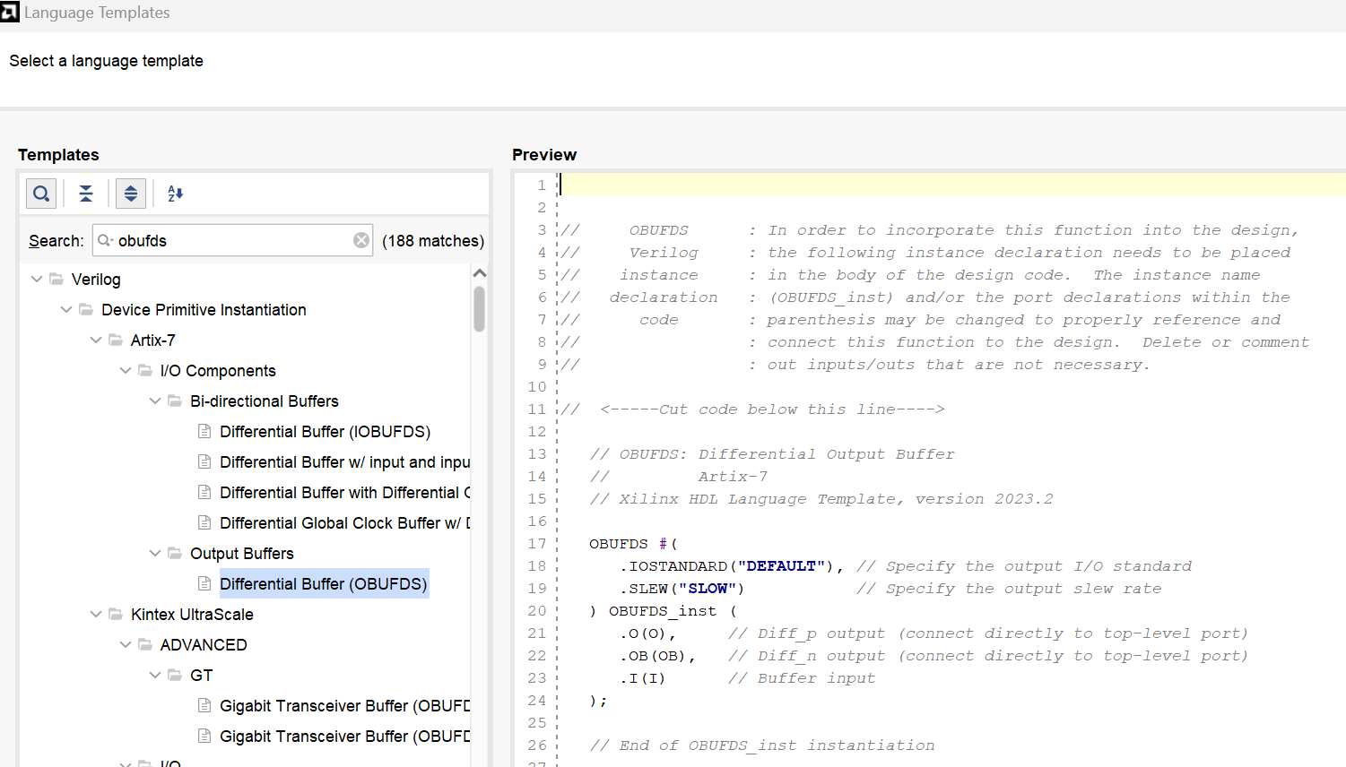
Parallel_to_serial
OBUFDS inst
//*****************************************************
//** main code
//*****************************************************
OBUFDS #(
.IOSTANDARD("DEFAULT"),
.SLEW("SLOW"))
OBUFDS_inst(
.O(dout_p),
.OB(dout_n),
.I(dout)
);

Slide 35
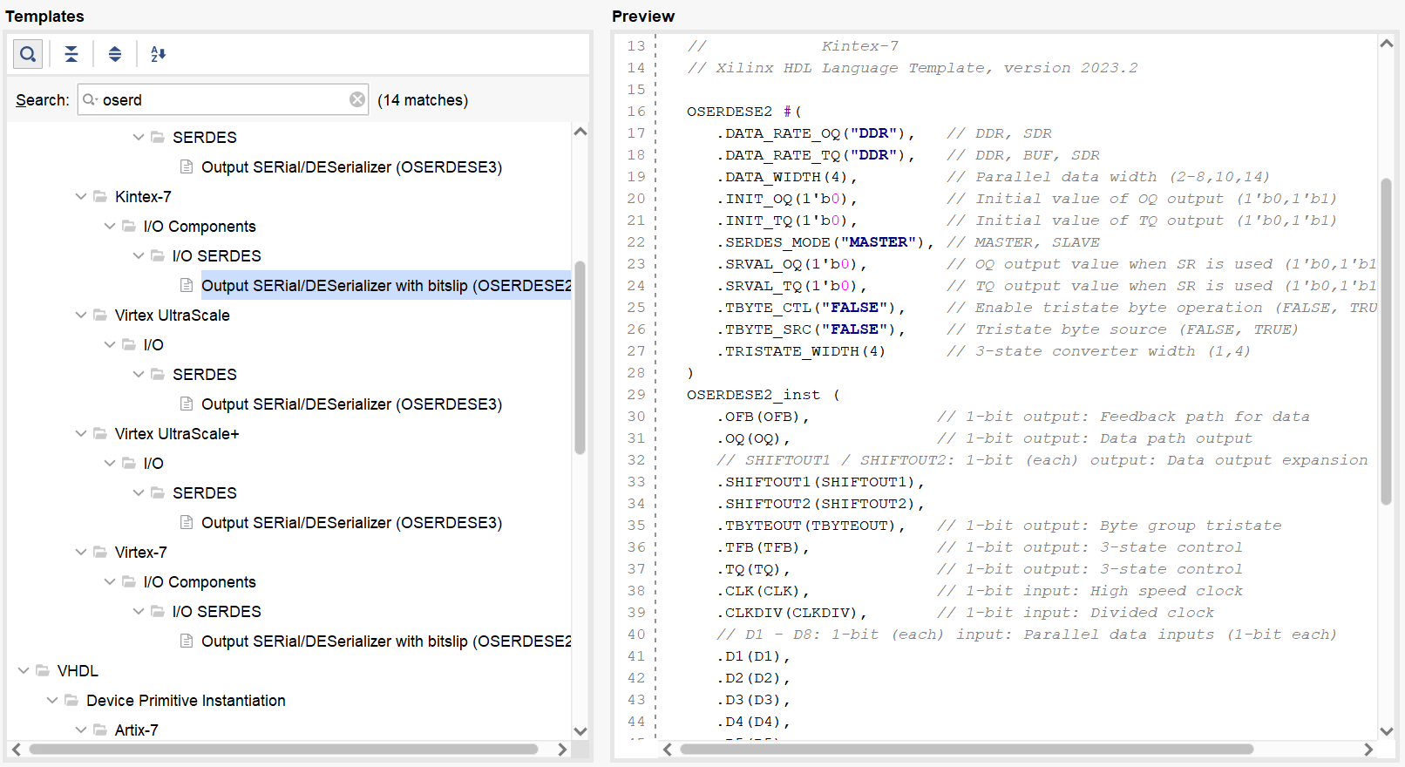
Parallel_to_serial
OSERDESE2_Master inst
OSERDESE2 #(
.DATA_RATE_OQ ("DDR"),
.DATA_RATE_TQ ("SDR"),
.DATA_WIDTH (10),
.INIT_OQ (1'b0),
.INIT_TQ (1'b0),
.SERDES_MODE ("MASTER"),
.SRVAL_OQ (1'b0),
.SRVAL_TQ (1'b0),
.TBYTE_CTL ("FALSE"),
.TBYTE_SRC ("FALSE"),
.TRISTATE_WIDTH (1)
)
OSERDESE2_inst_Master (
.OFB (),
.OQ (dout),
.SHIFTOUT1 (),
.SHIFTOUT2 (),
.TBYTEOUT (),
.TFB (),
.TQ (),
.CLK (clk5x),
.CLKDIV (clk1x),

Slide 36
Parallel_to_serial
OSERDESE2_Master inst
.D1 (din[0]),
.D2 (din[1]),
.D3 (din[2]),
.D4 (din[3]),
.D5 (din[4]),
.D6 (din[5]),
.D7 (din[6]),
.D8 (din[7]),
.OCE (1'b1),
.RST (rst),
.SHIFTIN1 (shift_in1),
.SHIFTIN2 (shift_in2),
.T1 (1'b0),
.T2 (1'b0),
.T3 (1'b0),
.T4 (1'b0),
.TBYTEIN (1'b0),
.TCE (1'b0)
);

Slide 37
Parallel_to_serial
OSERDESE2_Slave inst
OSERDESE2 #(
.DATA_RATE_OQ ("DDR"),
.DATA_RATE_TQ ("SDR"),
.DATA_WIDTH (10),
.INIT_OQ (1'b0),
.INIT_TQ (1'b0),
.SERDES_MODE ("SLAVE"),
.SRVAL_OQ (1'b0),
.SRVAL_TQ (1'b0),
.TBYTE_CTL ("FALSE"),
.TBYTE_SRC ("FALSE"),
.TRISTATE_WIDTH (1)
)
OSERDESE2_inst_slave (
.OFB (),
.OQ (),
.SHIFTOUT1 (shift_in1),
.SHIFTOUT2 (shift_in2),
.TBYTEOUT (),
.TFB (),
.TQ (),
.CLK (clk5x),
.CLKDIV (clk1x),

Slide 38
Parallel_to_serial
OSERDESE2_Slave inst
.D1 (),
.D2 (),
.D3 (din[8]),
.D4 (din[9]),
.D5 (),
.D6 (),
.D7 (),
.D8 (),
.OCE (1'b1),
.RST (rst),
.SHIFTIN1 (),
.SHIFTIN2 (),
.T1 (1'b0),
.T2 (1'b0),
.T3 (1'b0),
.T4 (1'b0),
.TBYTEIN (1'b0),
.TCE (1'b0)
);
endmodule

Slide 39
Parallel_to_serial
OSERDESE2_Slave inst
.D1 (),
.D2 (),
.D3 (din[8]),
.D4 (din[9]),
.D5 (),
.D6 (),
.D7 (),
.D8 (),
.OCE (1'b1),
.RST (rst),
.SHIFTIN1 (),
.SHIFTIN2 (),
.T1 (1'b0),
.T2 (1'b0),
.T3 (1'b0),
.T4 (1'b0),
.TBYTEIN (1'b0),
.TCE (1'b0)
);
endmodule

Slide 40
HDMI_Img
Hdmi_Trans
ROM
VPG
Encode
Parallel to Serial
Single end to Differential
TMDS [3:0]
Encode
Parallel to Serial
Single end to Differential
PLL
Encode
Parallel to Serial
Single end to Differential
Parallel to Serial
Single end to Differential
TMDSI_Tx_clk

Slide 41
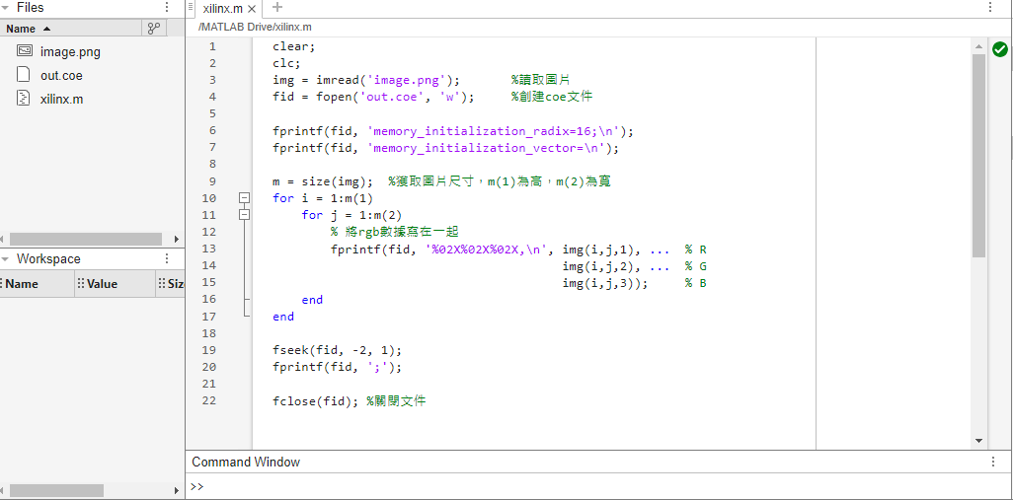
HDMI_img
透過Matlab將圖片轉成rgb編碼，並儲存成rom可以存取的coe檔案
clear;
clc;
img = imread('image.png'); %讀取圖片
fid = fopen('out.coe', 'w'); %創建coe文件
fprintf(fid, 'memory_initialization_radix=16;\n');
fprintf(fid, 'memory_initialization_vector=\n');
m = size(img); %獲取圖片尺寸，m(1)為高，m(2)為寬
for i = 1:m(1)
for j = 1:m(2)
% 將rgb數據寫在一起
fprintf(fid, '%02X%02X%02X,\n', img(i,j,1), ... % R
img(i,j,2), ... % G
img(i,j,3)); % B
end
end
fseek(fid, -2, 1);
fprintf(fid, ';');
fclose(fid); %關閉文件

Slide 42
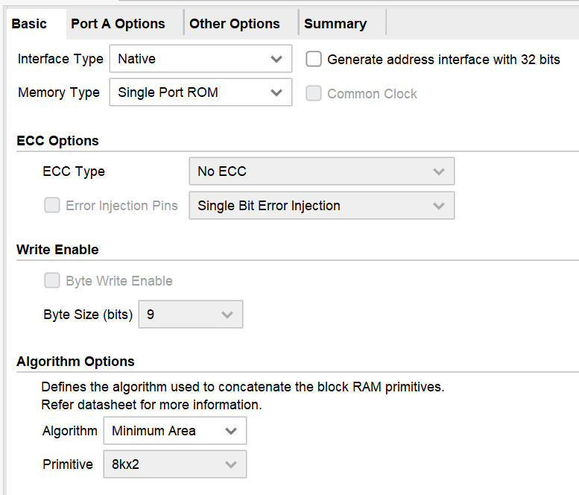
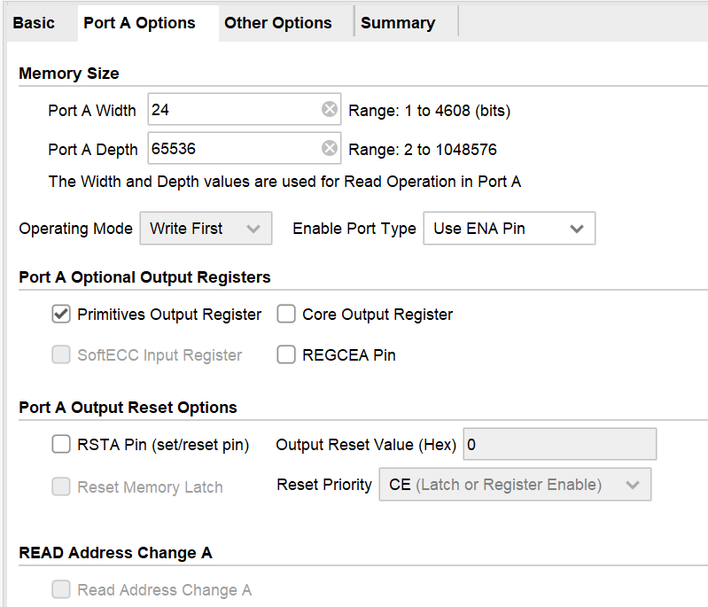
HDMI_img
Rom IP Setting

Slide 43
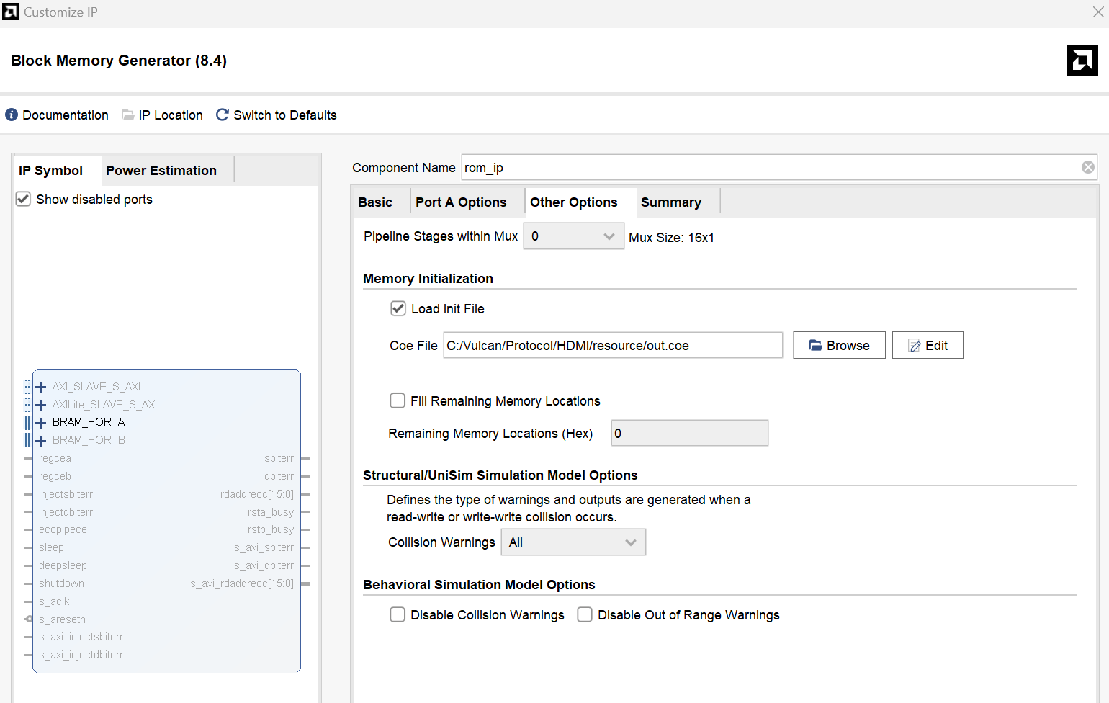
HDMI_img
Rom IP Setting

Slide 44
HDMI_trans_top
Rd_data & rd_req port
vga_shift inst_vga_shift
(
.rst(rst),
.vpg_pclk(clk1x),
.rd_data(rd_data),
.rd_req(rd_req),
.vpg_de(vpg_de),
.vpg_hs(vpg_hs),
.vpg_vs(vpg_vs),
.rgb_r(rgb_r),
.rgb_g(rgb_g),
.rgb_b(rgb_b)
);
rd_image inst_rd_image
(
.clk(clk1x),
.rst(rst),
.rd_req(rd_req),
.rd_data(rd_data)
);

Slide 45
Vga_shift
Port degine
`timescale 1ns / 1ps
module vga_shift(
input wire rst ,
input wire vpg_pclk ,
input wire [23:0] rd_data ,
output wire rd_req ,
output reg vpg_de ,
output reg vpg_hs ,
output reg vpg_vs ,
output wire [7:0] rgb_r ,
output wire [7:0] rgb_g ,
output wire [7:0] rgb_b
);

Slide 46
Vga_shift
Rd_data & rd_req
reg [12:0] cnt_h ;
reg [12:0] cnt_v ;
reg [11:0] x ;
reg flag_x ;
reg [11:0] y ;
reg flag_y ;
reg [23:0] rgb ;
reg rd_req_r;
assign {rgb_r , rgb_g , rgb_b } = rgb ;
assign rd_req = rd_req_r;

Slide 47
Vga_shift
Rd_data & rd_req
always@(posedge vpg_pclk)begin
if(rst)
rd_req_r <= 1'b0;
else if(cnt_h >= H_START+x-2 && cnt_h < H_START+SQUARE_X+x-2 && cnt_v >= V_START+y && cnt_v <=V_START+SQUARE_Y+y)
rd_req_r <= 1'b1;
else
rd_req_r <= 1'b0;
end
always@(posedge vpg_pclk)begin
if(rst)
rgb <= 'd0;
else if(cnt_h >= H_START+x && cnt_h < H_START+SQUARE_X+x && cnt_v >= V_START+y && cnt_v <= V_START+SQUARE_Y+y)
rgb <= {rd_data[7:0],rd_data[15:8],rd_data[23:16]};
else if(cnt_h >= H_START && cnt_h < H_END && cnt_v >= V_START && cnt_v <= V_END && cnt_h[4:0] >= 'd20)
rgb <= 24'h00FF00;
else if(cnt_h>=H_START && cnt_h<H_END && cnt_v>=V_START && cnt_v<=V_END && (cnt_h[4:0]>='d10 && cnt_h[2:0]<'d20))
rgb <= 24'h0000FF;
else if(cnt_h >= H_START && cnt_h < H_END && cnt_v >= V_START && cnt_v <= V_END && cnt_h[4:0] < 'd10)
rgb <= 24'hFF0000;
else
rgb <= 'd0;
end

Slide 48
Rd_img
Read rom data
`timescale 1ns / 1ps
module rd_image(
input wire clk,
input wire rst,
input wire rd_req,
output wire [23:0] rd_data
);
parameter STOP_ADDR = 256*256-1; reg [15:0] rd_addr;
wire [23:0] dout;
assign rd_data = dout; always@(posedge clk)begin
if(rst)
rd_addr <= 'd0;
else if(rd_req == 1'b1)
rd_addr <= (rd_addr == STOP_ADDR) ? 'd0 : rd_addr + 1'b1;
end
rom_ip inst_rom(
.clka(clk),
.addra(rd_addr),
.douta(dout));
endmodule

Slide 49
HDMI_loop
PLL
Dvi2rgb
(HDMI_Tx)
Rgb2dvi
(HDMI_RX)
Video_in
Video_out

Slide 50
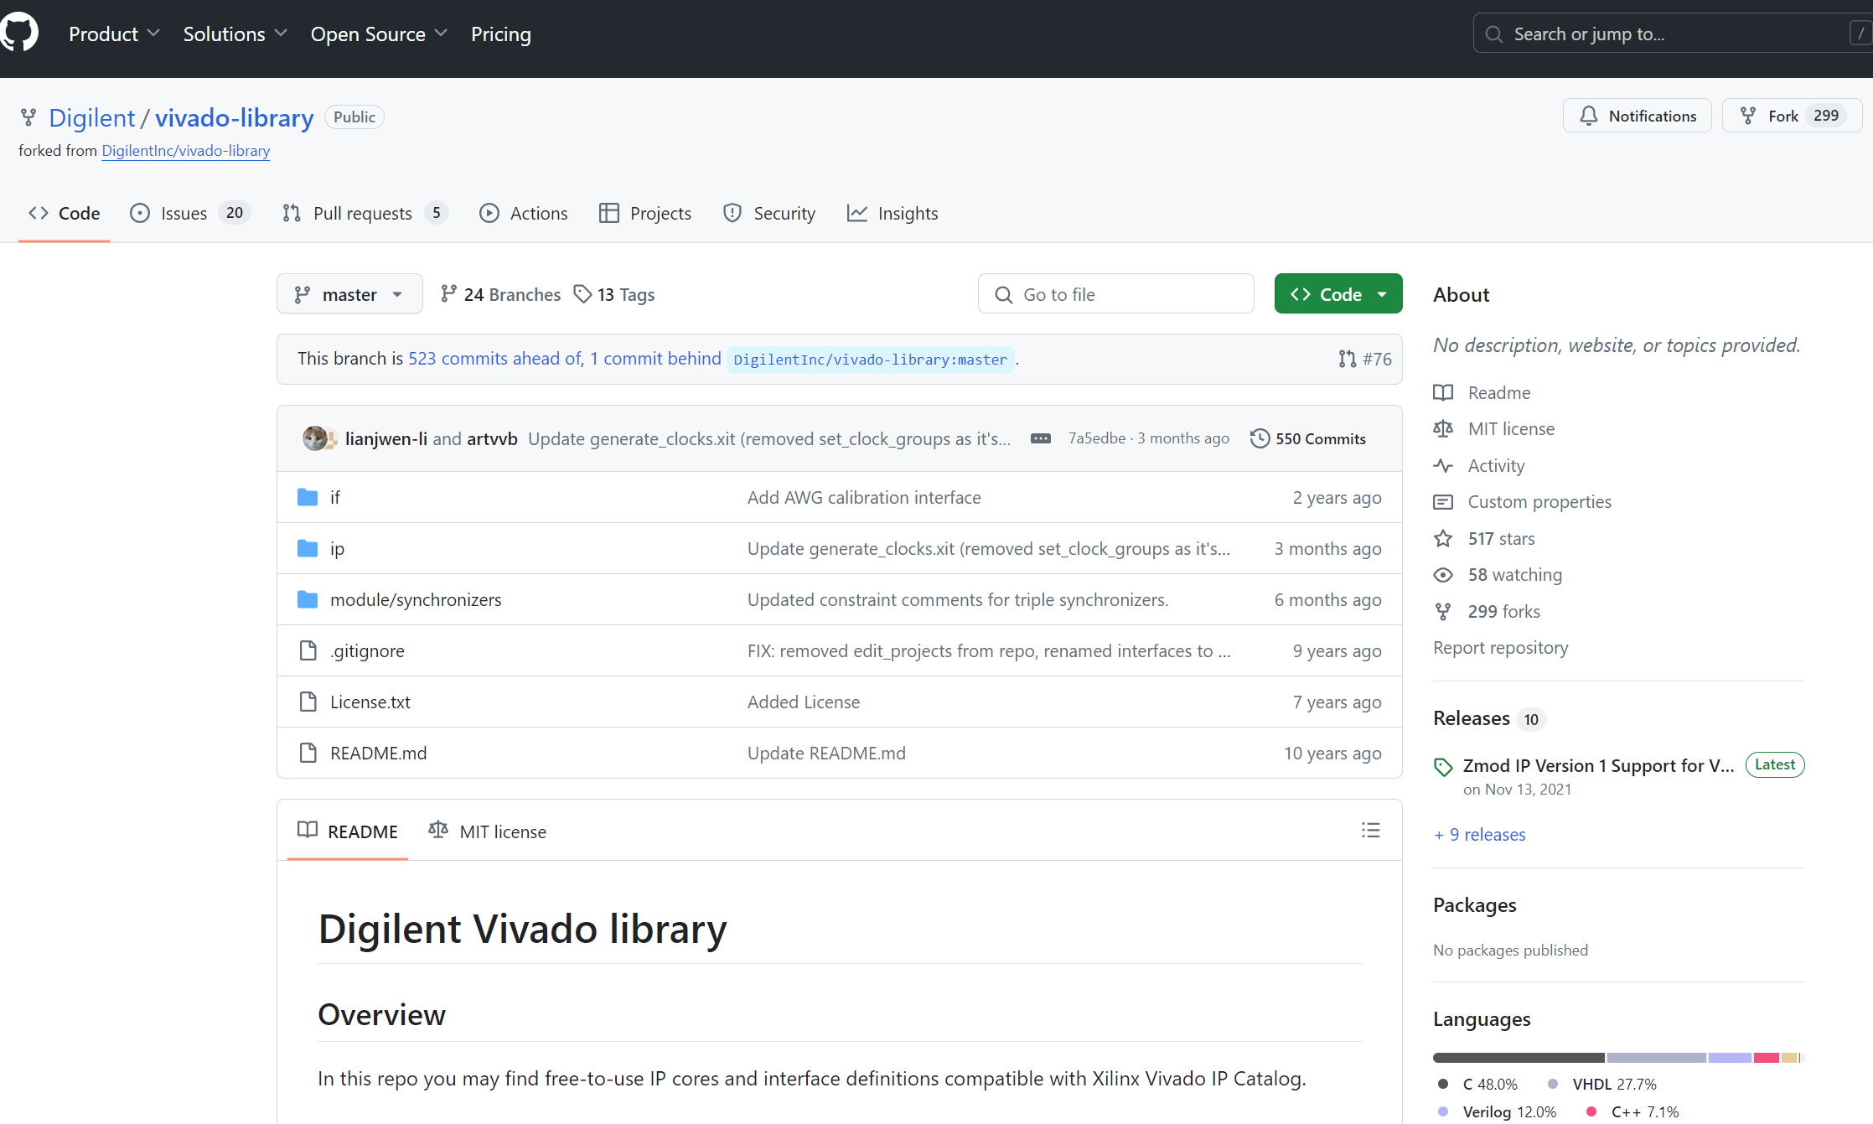
HDMI_loop
這次改使用現成IP的方式來完成HDMI Loop
https://github.com/Digilent/vivado-library

Slide 51
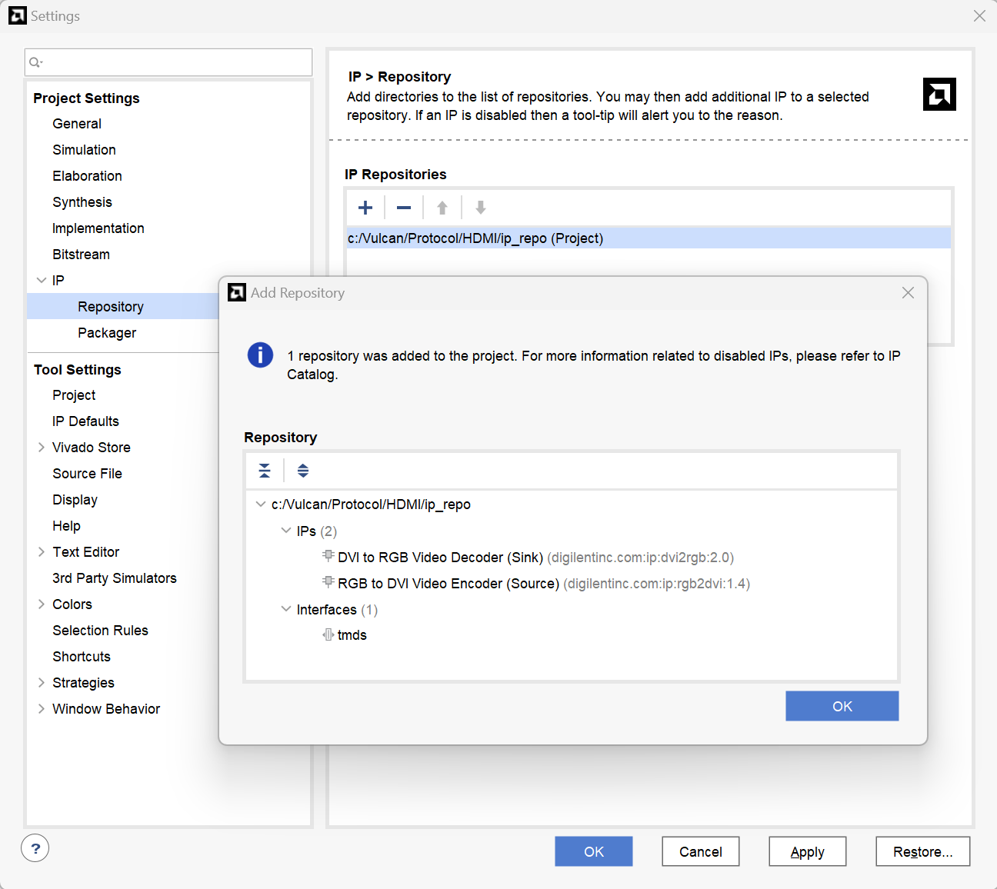
HDMI_loop
使用tmds(interface)及dvi2rgb & rgb2dvi(ip)

Slide 52
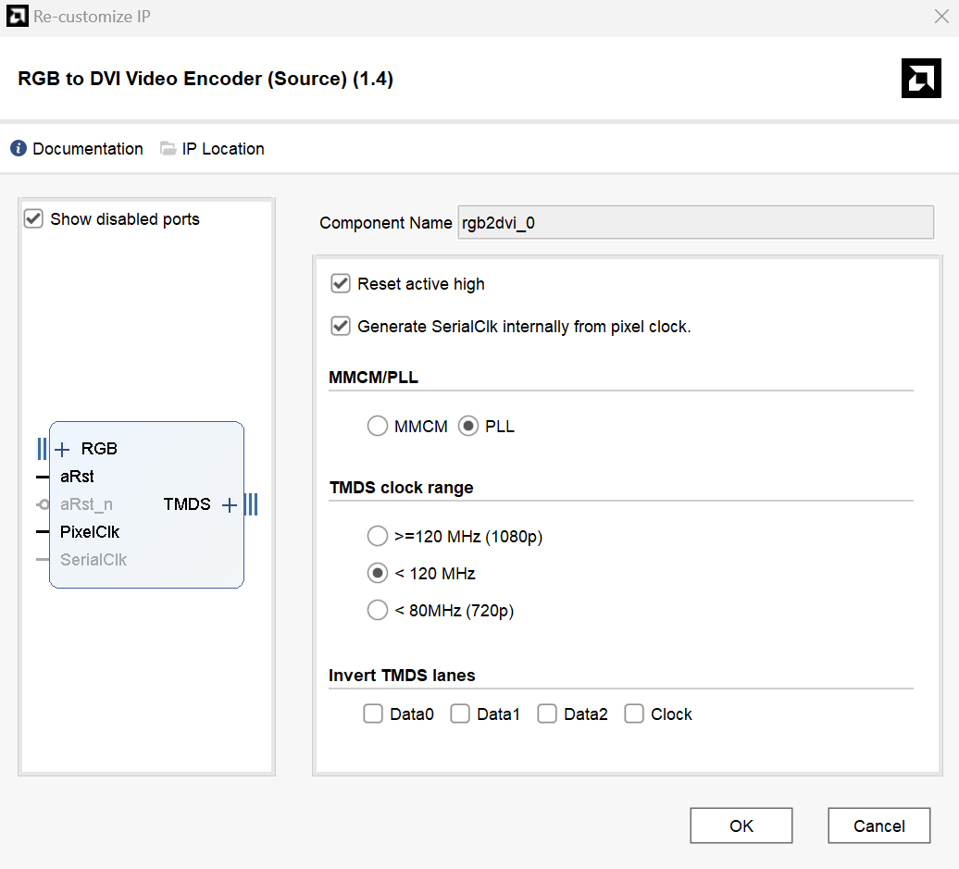
HDMI_loop
IP Setting

Slide 53
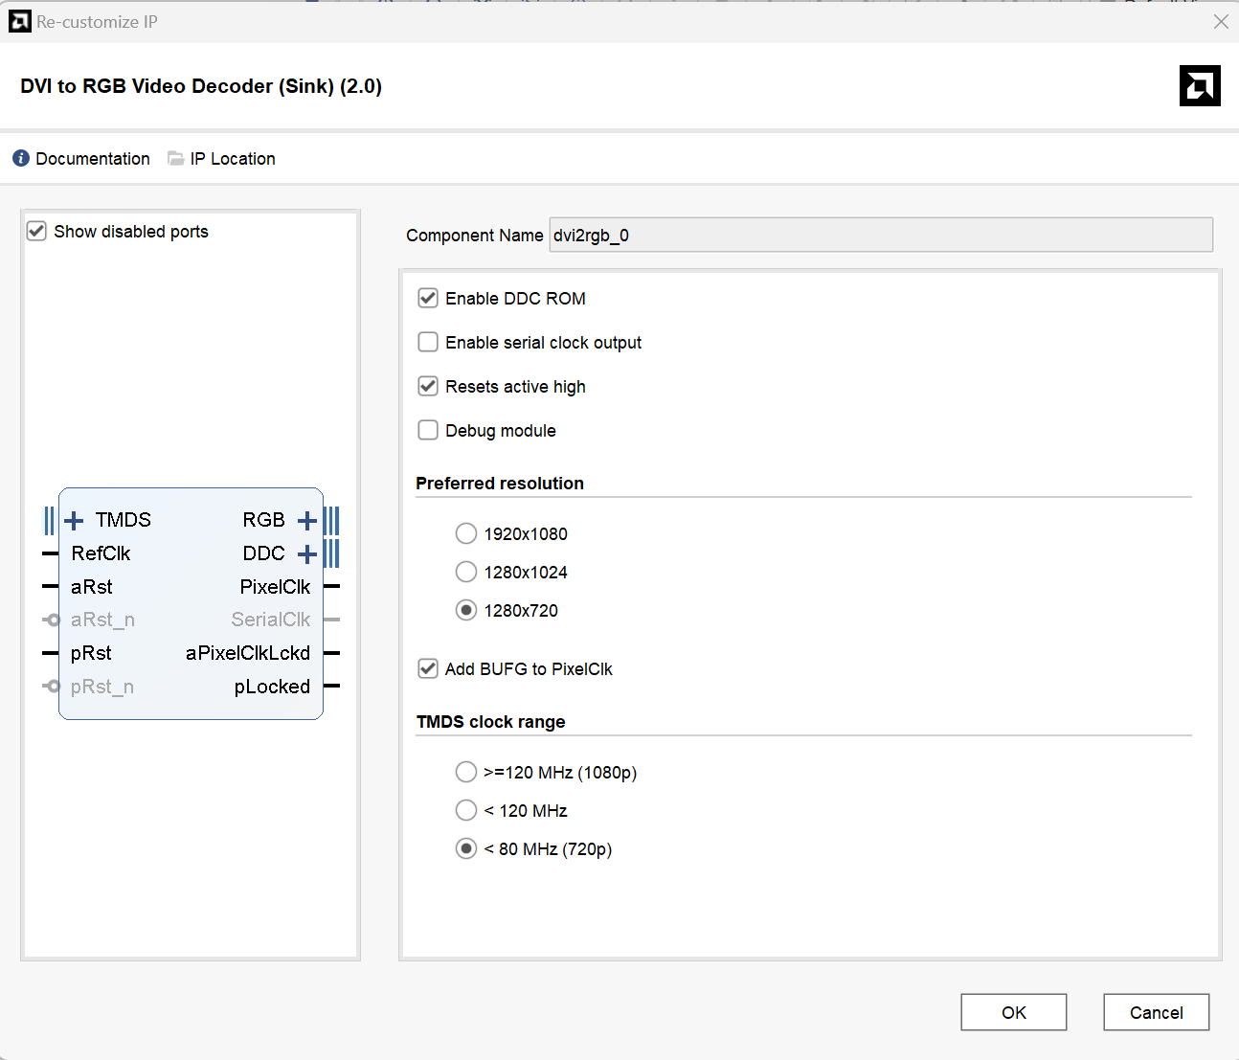
HDMI_loop
IP Setting

Slide 54
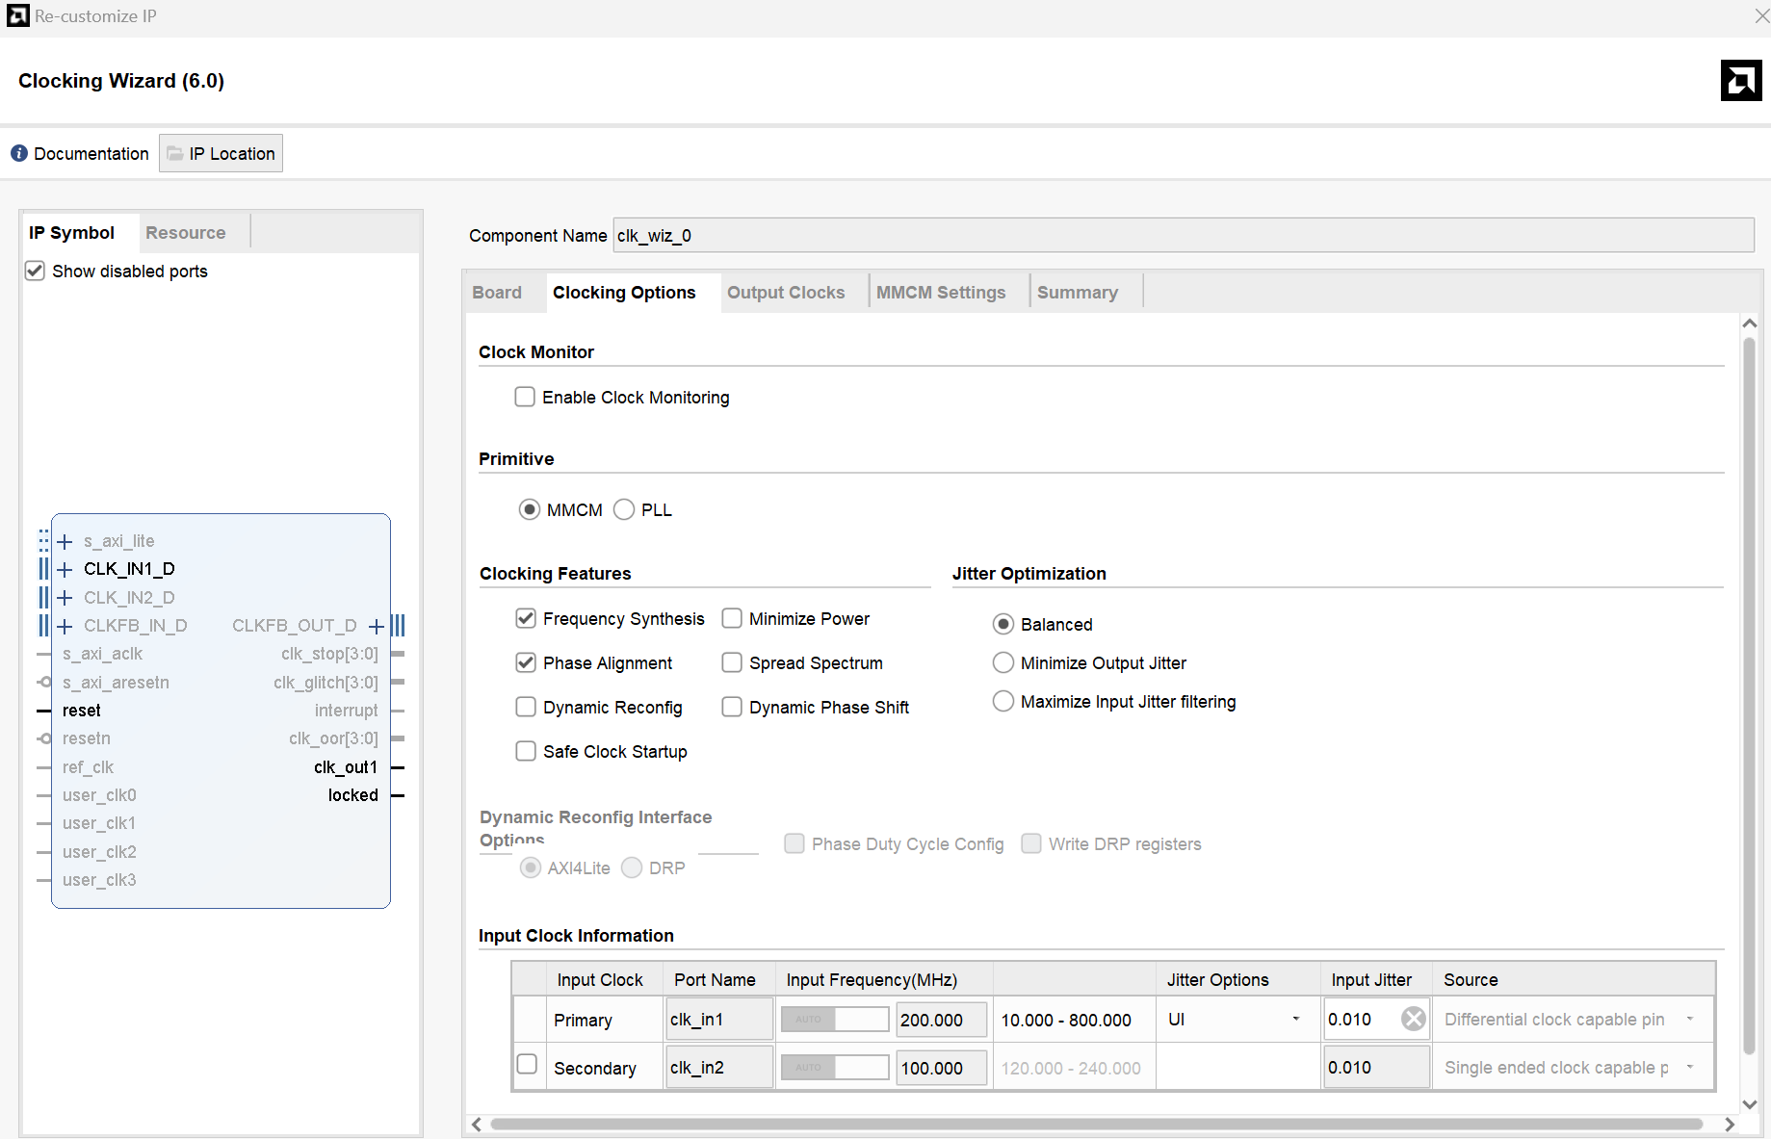
HDMI_loop
IP Setting

Slide 55
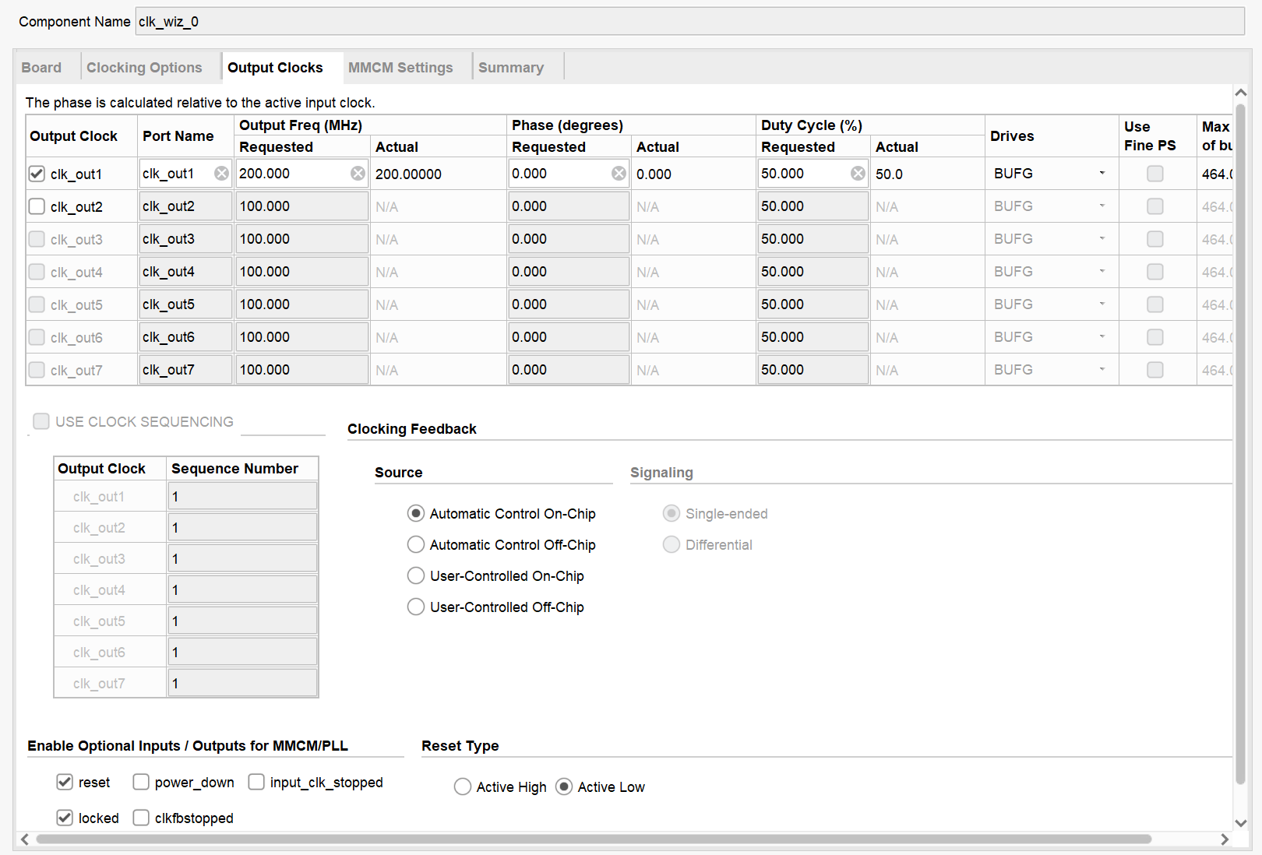
HDMI_loop
IP Setting

Slide 56
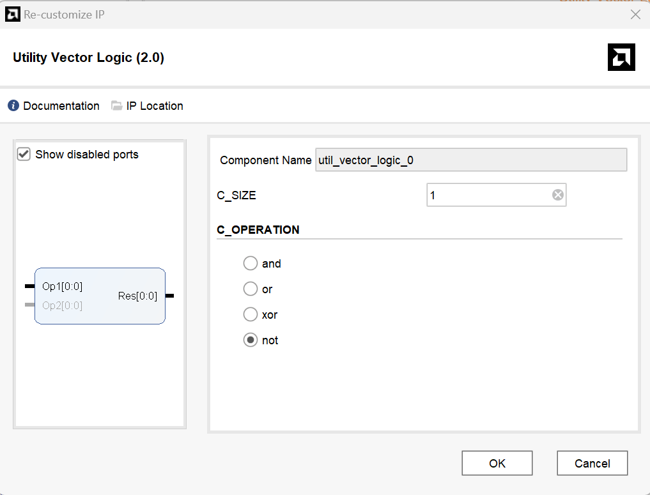
HDMI_loop
IP Setting

Slide 57
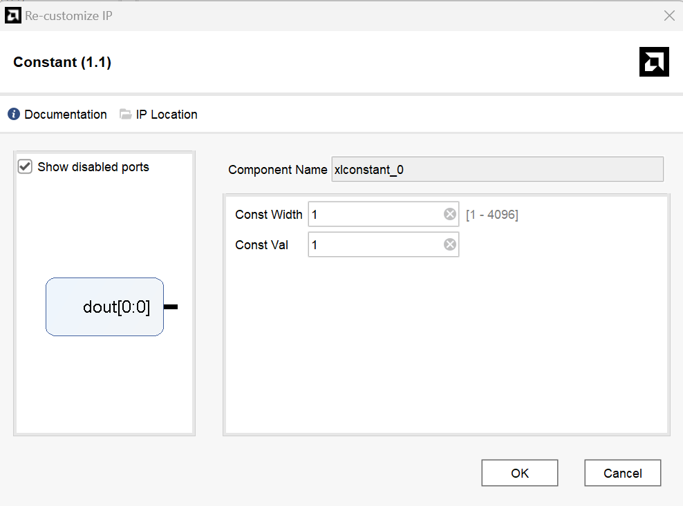
HDMI_loop
IP Setting

Slide 58
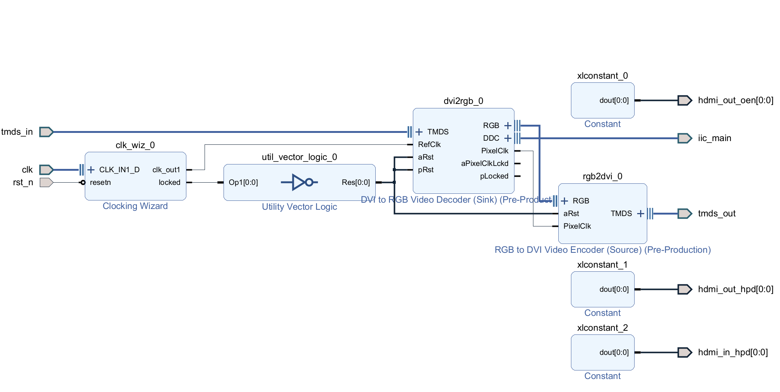
HDMI_loop
Final Block Design

Slide 59


◢ [Confidential - Distribution with NDA]

